Slide 1

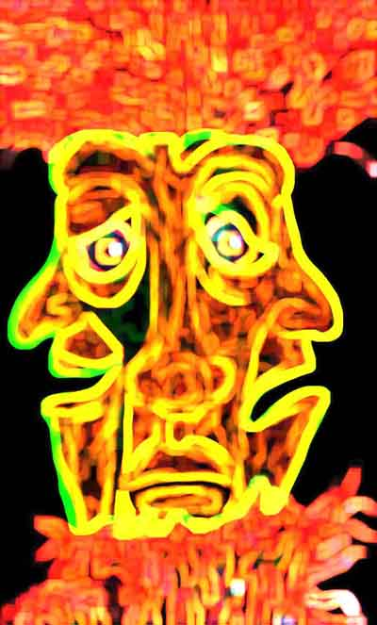


ECE 5345
Analysis & Processing of Random Signals- Filtering RP’s

Slide 2
Analysis & Processing of Random Signals- Filtering RP’s
Deterministic input, deterministic linear system
Linear means (a) additivity and (b) homogeneity
Linear System
x(t)
y(t)

Slide 3

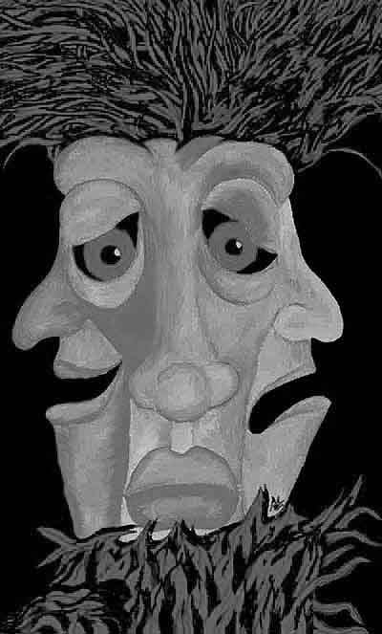
Filtering RP’s
Stochastic input, deterministic linear system
Linear System
X(t)
Y(t)
Expectation and linear operations commute:

Slide 4
Analysis & Processing of Random Signals- Filtering RP’s
Deterministic input, deterministic LTI system
LTI
x(t)
y(t)

Slide 5
Filtering RP’s
Stochastic input, deterministic LTI system
LTI System
X(t)
Y(t)

Slide 6
Filtering RP’s:
Nonstationary Case
LTI System
X(t)
Y(t)

Slide 7
Filtering RP’s
LTI System
X(t)
Y(t)

Slide 8
Filtering RP’s
LTI System
X(t)
Y(t)

Slide 9
Differentiation of RP’s

Slide 10
Stochastic Differential Equations
Stochastic Differential Equations
Given the (nonstationary) correlation of X, find the particular (forced) solution for
and

Slide 11
Stochastic Differential Equations
Stochastic Differential Equations
Cross Correlation:
Recall Linear Operations and Expectation Commute. Thus…

Slide 12
Stochastic Differential Equations
Stochastic Differential Equations
Fix τ and solve the differential equation
Particular solution: zero initial conditions…
Thus, the DE initial conditions are…

Slide 13
Stochastic Differential Equations
Stochastic Differential Equations
Finding the autocorrelation of Y.
Thus…

Slide 14
Stochastic Differential Equations
Stochastic Differential Equations
Fix τ and solve the differential equation
Particular solution: zero initial conditions…
Thus, the DE initial conditions are…

Slide 15
Stochastic Differential Equations
Stochastic Differential Equations
Summary. Given autocorrelation of X and,
Solve two differential equations…
with corresponding initial conditions…

Slide 16

Filtering WSS RP’s
If input is WSS, so is output! Mean:

Slide 17

Filtering WSS RP’s
If input is WSS, so is output! Autocorrelation:
?
Not a function of t ⇒ WSS!!!
p. 415

Slide 18
Filtering WSS RP’s
Power Spectral Density: Final result
LTI System
X(t)
Y(t)
p. 415

Slide 19
Filtering WSS RP’s
Power Spectral Density: Discrete time systems
LTI System
X[n]
Y[n]
p. 415

Slide 20
Filtering WSS RP’s: Example
Input: Zero Mean White Noise
LTI System
X(t)
Y(t)
Example: p. 418

Slide 21
Filtering WSS RP’s: Example
Low Pass, High Pass & Band Pass Filters
LPF
X(t)
Y(t)
Example: p. 418

Slide 22
S_{X}(f) ≥ 0 Proof
Consider filter
1
f ₀ f ₀ +df
Y(t) will have a PSD
Thus:
⇐ A PSD property

Slide 23
Filtering WSS RP’s: Derivatives
Derivatives: If X(t) is differentiable, let

Slide 24
Filtering WSS RP’s: ARMA
ARMA: IIR filter with white WSS input
LTI System
X[n]
Y[n]
Example: p. 421

Slide 25

Filtering WSS RP’s
Autocorrelation: Final result summary.
LTI System
X(t)
Y(t)
p. 415

