Slide 1

ECE 5345
Random Processes - Stationary Random Processes

Slide 2
Random Processes -
Stationary Random Processes
Stationary Random Processes: The stochastic process does not change character with respect to time.
Examples
Types
  Strict stationarity
  Stationary in the Wide Sense (Wide Sense Stationary)
Cyclostationary - stationary in a periodic sense

Slide 3
Strict Stationarity
X(t) is stationary in the strict sense if, for all k and τ and choices of (t₁, t_{2…,} t_{k} ),
In other words, all CDF’s are independent of the choice of time origin.

Slide 4
Strict Stationarity-example
All iid random processes are strictly stationary. Using continuous notation…

Slide 5
Strict Stationarity-example
The telegraph signal is strict sense stationary when the origin is randomized with a 50-50 coin flip (see the Flip Theorem) . Using independent increment property:
Substituting gives the same results!

Slide 6

Strict Stationarity: necessary conditions
If X(t) is stationary in the strict sense,
  the mean is a constant for all time
  The autocorrelation is a function of the distance between the points only
  Note: In 2, autocovariance could be substituted with autocorrelation with the same result.

Slide 7
Wide Sense Stationarity RP’s
X(t) is wide sense stationary if
  The mean is a constant for all time
  The autocovariance is a function of the distance between the points only
  Notes:
  In 2, autocovariance could be substituted with autocorrelation with the same result.
  All strictly stationary processes are wide sense stationary

Slide 8
Wide Sense Stationarity RP’s: Average Power
Recall average power
In general
Thus
If X(t) is wide sense stationary, this means
If you stick your finger in a socket, this is what you feel

Slide 9
Wide Sense Stationarity RP’s: Average Power Example
Let everything but Θ be fixed in the stochastic process
Then
And
Then X(t) is wide sense stationary, with
And
Recall rms voltage of a sinusoid

Slide 10








Wide Sense Stationarity RP’s: Autocorrelation Properties
To characterize a WSS process, need (a) the mean and (b) the autocorrelation.
How to estimate empirically?
$$X(t)$$
$$X(t+τ)$$
$$R_{X}(τ)$$
$$E[X^{2}]$$
$$E[X]$$
$$t$$
$$t+τ$$
$$τ$$

Slide 11

Wide Sense Stationarity RP’s: Autocorrelation Properties
Proof
quod erat demonstrandum

Slide 12
Wide Sense Stationarity RP’s: Autocorrelation Properties
3.
Proof: Recall
If X(t) is zero mean,
or
This is even true when X(t) is not zero mean. The desired result follows immediately.
quod erat demonstrandum

Slide 13
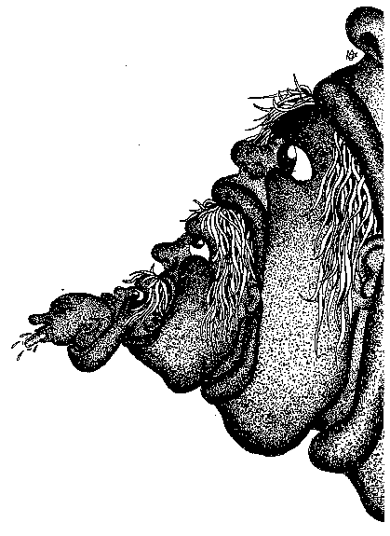
Wide Sense Stationarity RP’s: Autocorrelation Properties
4. If for some τ > 0,
then is a periodic function.
Example: Recall sinusoid
with random phase.
p.361

Slide 14
Cyclostationary RP’s:
For a given time interval (period) T, the behavior of the process on each period has the same character.
Cyclostationary in the strict sense

Slide 15

Cyclostationary RP’s:
Cyclostationary in the strict sense example. Let A be a random variable and define
This RP is cyclostationary in the strict sense with

Slide 16
Wide Sense Cyclostationary RP’s:

