Slide 1

ECE 5345
Random Processes - Example Random Processes

Slide 2
Example RP’s
Example Random Processes
  Gaussian
  Recall Gaussian pdf
  Let X_{k}=X(t_{k}) , 1 ≤ k ≤ n. Then if, for all n, the corresponding pdf’s are Gaussian, then the RP is Gaussian.
  The Gaussian RP is a useful model in signal processing.

Slide 3
Flip Theorem
Let A take on values of +1 and -1 with equal probability
Let X(t) have mean m(t) and autocorrelation R_{X}
Let Y(t)=AX(t)
Then Y(t) has mean zero and autocorrelation R_{X}
What about the autocovariances?

Slide 4

Multiple RP’s
  X(t) & Y(t)
  Independence
  (X(t₁), X(t₂), …, X(t_{k} ))
  is independent to
  (Y(τ₁), Y(τ ₂), …, Y(τ _{j} ))
  …for All choices of k and j and
  all sample locations

Slide 5
Multiple RP’s
  X(t) & Y(t)
  Cross Correlation
  R_{XY}(t, τ )=E[X(t)Y(τ)]
  Cross-Covariance
  C_{XY}(t, τ )= R_{XY}(t, τ ) - E[X(t)] E[Y(τ)]
  Orthogonal: R_{XY}(t, τ ) = 0
  Uncorrelated: C_{XY}(t, τ ) = 0

Slide 6
Example RP’s
Multiple Random Process Examples
  Example
    X(t) = cos(ωt+Θ), Y(t) = sin(ωt+Θ),
    Both are zero mean.
    Cross Correlation=?

Slide 7
Example RP’s
Multiple Random Process Examples
  Signal + Noise
    X(t) = signal, N(t) = noise
    Y(t) = X(t) + N(t)
    If X & N are independent, R_{XN}=? p.338
    Note: also, var Y = var X + var N

Slide 8

Example RP’s
Multiple Random Process Examples (cont)
  Discrete time RP’s
    X[n]
    Mean
    Variance
    Autocorrelation
    Autocovariance
  Discrete time i.i.d. RP’s
    Bernoulli RP’s ⇒ Binomial RP’s p.340
      Binary vs. Bipolar
    Random Walk p.341-2

Slide 9

Autocovariance of Sum Processes
X[k]’s are iid.
Autocovariance:

Slide 10
Autocovariance of Sum Processes
When i=j, the answer is var(X). Otherwise, zero.
How many cases are there where i = j?

Slide 11

Autocovariance of Sum Processes
For Bernoulli sum process,
For Bipolar case

Slide 12
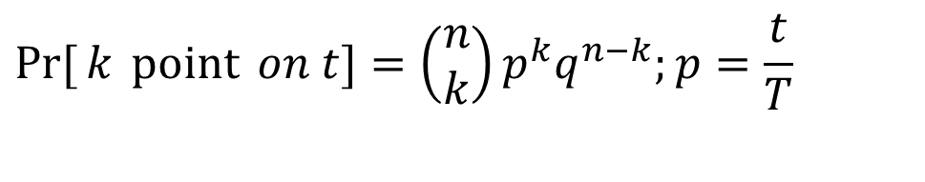
Continuous Random Processes
Poisson Random Process
  Place n points randomly on line of length T
t
  Choose any subinterval of length t.
T
  The probability of finding k points on the subinterval is
$$\operatorname{Pr}{[}k \operatorname{point}{ on t}]=\left(\begin{aligned}&n \\ &k\end{aligned}\right)p^{k}q^{n−k};p=\frac{t}{T}$$

Slide 13
Continuous Random Processes
Poisson Random Process (cont)
  The Poisson approximation: For k big and p small…

Slide 14
Continuous Random Processes
The Poisson Approximation…
  For n big and p small (implies k << n since p≈ k/n<<1)
Here’s why…

Slide 15
Continuous Random Processes
Poisson Random Process (cont)
  Let n→ ∞ such that λ=n/T = frequency of points remains constant.

Slide 16
Continuous Random Processes
Poisson Random Process (cont)
  This is a Poisson process with parameter
  λ occurrences per unit time
  Examples: Modeling
    Popcorn
    Rain (Both in space and time)
    Passing cars
    Shot noise
    Packet arrival times
t

Slide 17
Continuous Random Processes
Poisson Counting Process
Poisson Points

Slide 18
Continuous Random Processes
Recall for Poisson RV with parameter a
Poisson Counting Process Expected Value is thus

Slide 19
Continuous Random Processes
The Poisson Counting Process is independent increment process. Thus, for τ ≥ t and j ≥ i,

Slide 20
Continuous Random Processes
t
τ
Autocorrelation: If τ > t

Slide 21
Continuous Random Processes
Autocovariance of a Poisson sum process

Slide 22
Continuous Random Processes
Other RP’s related to the Poisson process
  Random telegraph signal
Poisson Points

Slide 23

Poisson Random Processes
  Random telegraph signal
PROOF…

Slide 24
Poisson Random Processes
  Random telegraph signal. For t>0,

Slide 25
Poisson Random Processes
  Random telegraph signal. For t>0,

Slide 26
Poisson Random Processes
  Random telegraph signal. For t>0.
  Similarly…

Slide 27
Poisson Random Processes
  Random telegraph signal. For t>0.
  Thus
For all t…

Slide 28
Poisson Random Processes
  Random telegraph signal. For t > τ,
X(τ)
1
-1
1
X(t)
-1

Slide 29
Poisson Random Processes
  Random telegraph signal. For t > τ,
Thus…

Slide 30
Poisson Random Processes
  Random telegraph signal. For t > τ,
X(τ)
1
And…
-1
1
X(t)
-1

Slide 31
Poisson Random Processes
  Random telegraph signal. For t > τ.
Onward…

Slide 32
Poisson Random Processes
  Random telegraph signal. For t > τ.
X(τ)
1
And…
-1
1
X(t)
-1

Slide 33
Poisson Random Processes
  Random telegraph signal. For t > τ.
X(τ)
1
And…
-1
1
X(t)
-1

Slide 34
Poisson Random Processes
  Random telegraph signal. For t > τ.
X(τ)
1
-1
1
X(t)
-1
In general…

Slide 35
Continuous Random Processes
Other RP’s related to the Poisson process
  Poisson point process, Z(t)
  Let X(t) be a Poisson sum process. Then
  pp.352
Poisson Points

Slide 36
Continuous Random Processes
Other RP’s related to the Poisson process
  Shot Noise, V(t)
  Z(t) V(t)
  pp.352
h(t)
Poisson Points

Slide 37



Continuous Random Processes
Poisson process
  pp.352
$$λ$$
$$X(t)$$
$$T$$
Poisson Points

Slide 38
Continuous Random Processes
Wiener Process
  Assume bipolar Bernoulli sum process with jump bilateral height h and time interval δ
  E[X(t)]=0; Var X(nδ) = 4npqh ² = nh ²
  Take limit as h→ 0 and δ → 0 keeping α = h ² / δ constant and t = n δ.
  Then Var X(t) → α t
  By the central limit theorem, X(t) is Gaussian with zero mean and Var X(t) = α t
  We could use any zero mean process to generate the Wiener process.
  p.355

Slide 39
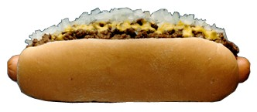
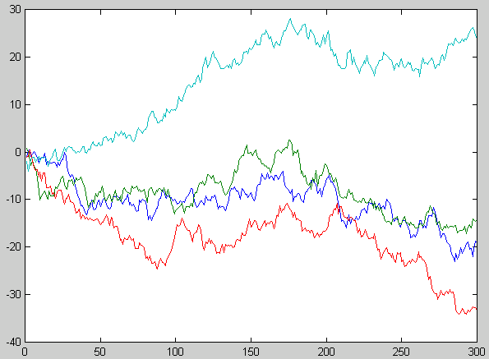
Continuous Random Processes
Wiener Processes: α =1

Slide 40
Continuous Random Processes
Wiener processes in finance
S= Price of a Security. μ = inflationary force.
If there is no risk…interest earned is proportional to investment.
Solution is
With “volatility” σ, we have the most commonly used model in finance for a security:
V(t) is a Wiener process.

