Slide 1

ECE 5345
Random Processes (cont)

Slide 2
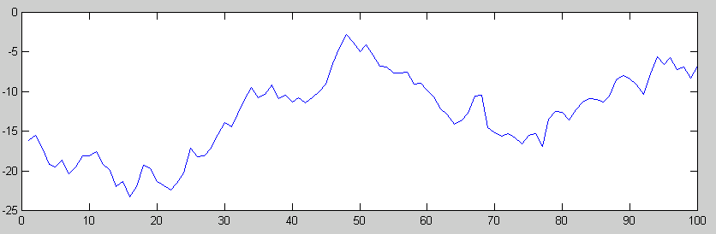

First & Second Order RP Moments
First & Second Order RP Moments
In many important cases, the first and second order statistics suffice as a RP characterization.
First order looks at parameters at a point:
X(t)

Slide 3
First & Second Order RP Moments
First & Second Order RP Moments
First Order
  Mean
  Second Moment
  Standard Deviation

Slide 4
First & Second Order RP Moments
First & Second Order RP Moments
First Order (cont)
  Average power on a 1 ohm basis
    X(t) is a voltage (or current) through a 1 ohm resister.
    The average power is
    Thus, the second moment is associated with power.

Slide 5
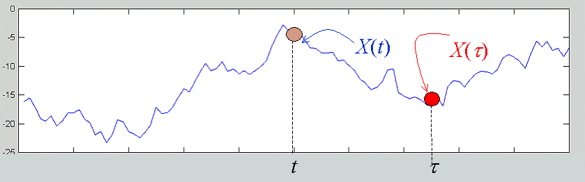
First & Second Order RP Moments
First & Second Order RP Moments
Second Order: Two points, t and τ.
Autocorrelation
Autocovariance

Slide 6
First & Second Order RP Moments
First & Second Order RP Moments
Special Cases
  Autocorrelation
  Autocovariance

Slide 7
First & Second Order RP Moments
First & Second Order RP Moments
Correlation Coefficient

Slide 8
First & Second Order RP Moments
First & Second Order RP Moments
Example: X(t) = A cos(Ω t).
A ~ N(0,1); Ω ~ uniform on (0,2π)
A and Ω are independent

Slide 9
First & Second Order RP Moments
First & Second Order RP Moments
Mean of X(t) = A cos(Ω t)

Slide 10
First & Second Order RP Moments
First & Second Order RP Moments
Autocorrelation of X(t) = A cos(Ω t)

Slide 11
First & Second Order RP Moments
First & Second Order RP Moments
Autocorrelation of X(t) = A cos(Ω t)
Why?

Slide 12
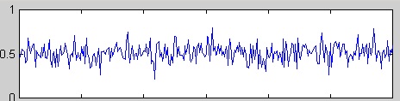
First & Second Order RP Moments
First & Second Order RP Moments
  i.i.d. process X[n]=A_{n}
Autocorrelation:
Autocovariance:

Slide 13
First & Second Order RP Moments
First & Second Order RP Moments
Autocovariance

Slide 14
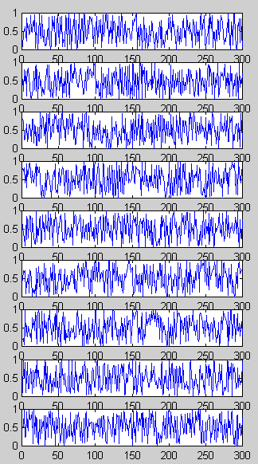
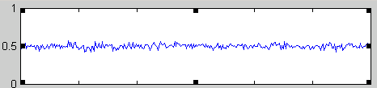
First & Second Order RP Moments
First & Second Order RP Moments
X₁(t)
X₂(t)
X₃(t)
X₄(t)
X₅(t)
X₆(t)
X₇(t)
X₈(t)
X₉(t)
Ensemble Averages
  For n = 100

Slide 15
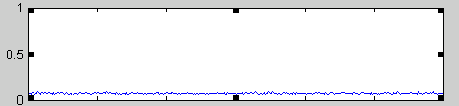
First & Second Order RP Moments
First & Second Order RP Moments
Ensemble Averages
  For n = 100
  variance of uniform = 1/12 = 0.0833

Slide 16
First & Second Order RP Moments
First & Second Order RP Moments
Ensemble Histograms

Slide 17
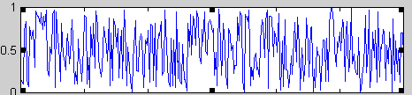
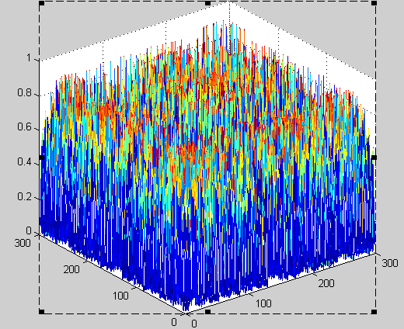
First & Second Order RP Moments
First & Second Order RP Moments
Ensemble Averages
Outer Product
X(t)
X(t) X(τ)

Slide 18
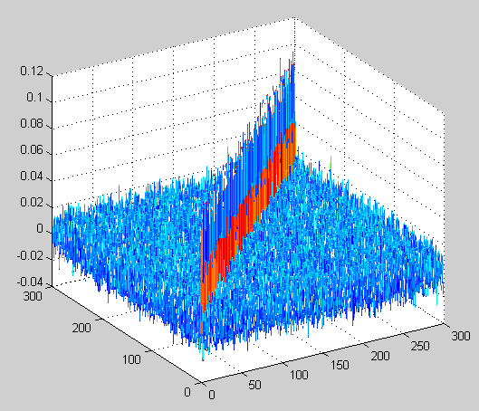
First & Second Order RP Moments
First & Second Order RP Moments
Sample Autocorrelation and Autocovariance
n=100

