Slide 1
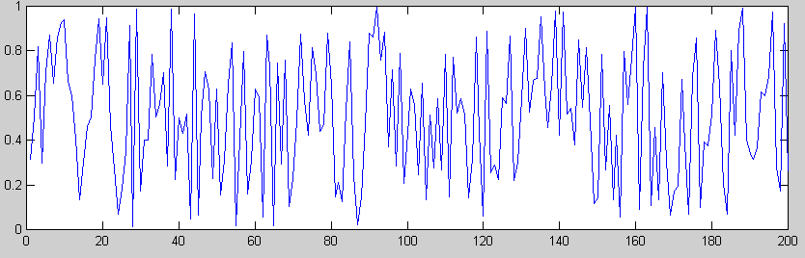
ECE 5345
Stochastic Processes

Slide 2
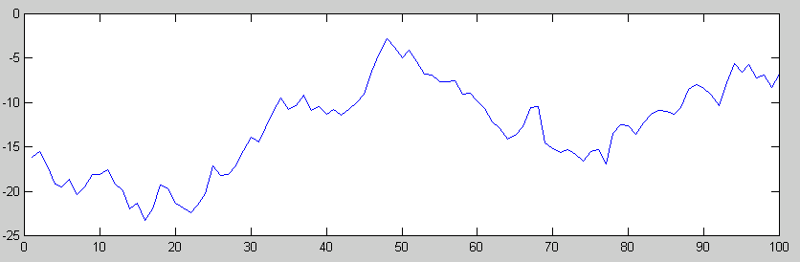
Random Processes
Random Processes
A Random process, X(t), is a random variable as a function of time.
In discrete time, the process is X[n].
X(t)
X(50)
t

Slide 3
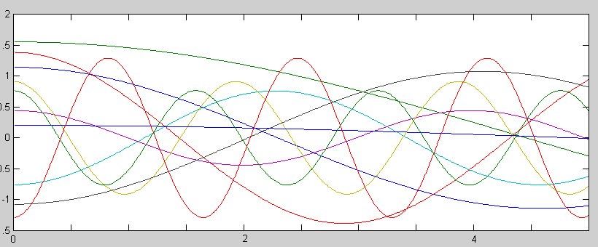
Random Processes
Random Processes
Example: X(t) = A cos(Ω t).
A ~ N(0,1); Ω ~ uniform on (0,2π)
X(t)’s
t

Slide 4
Random Processes
Random Processes
First order densities…
Pr[ X(t) ≤ x ] = F _{X(t)} (x;t)
f_{X(t)} (x;t)= ^{d}/_{dx} F _{X(t)} (x;t)

Slide 5
Random Processes
Random Processes
First order distributions: One point at a time.
X(t)
t

Slide 6
Random Processes
Random Processes
Second order distributions: Two points at a time.
X(t)
X(τ)
t τ
The pdf’s vary with t and τ.

Slide 7
Random Processes
Random Processes
kth order distributions: k points at given times.
X(t₄)
X(t₁)
X(t₅)
X(t₃)
X(t₂)
t₃ t₂ t₁ t₅ t₄

Slide 8
Random Processes
Random Processes
Discrete distributions: X(t) can take on only discrete (integer) values.
Probability mass function:
Do not confuse distributions with discrete values with random variable in discrete time, X[n]:

Slide 9
Random Processes
Random Processes
X(t)
3
2
1
0
t
Random variable with discrete values (quantization)
Random variable in discrete time
X[n]
3
2
1
0
n

Slide 10
Random Processes
Random Processes
Example Random Process Types.
1. X(t) has Independent Increments if ∀ k and
t₁ < t₂< …< t_{k}
Then
X(t₂)- X(t₁), X(t₃)- X(t₂),…, X(t_{k})- X(t_{k-1})
are independent.
e.g. A running sub-total.

Slide 11
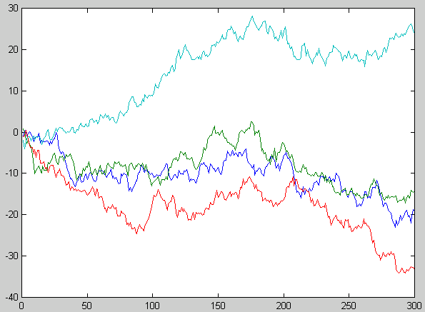
Random Processes
Random Processes
Independent Increments e.g. A running sub-total of gaussian RV’s is a Wiener process. Below, we use N(0,1).
Random walk - used in stock market models.

Slide 12
Random Processes
2. X(t) is Markov if ∀ k and
t₁ < t₂< …< t_{k}
if X(t) is discrete valued,
Pr[X(t_{k})= x_{k} | X(t_{k-1})]
= Pr[X(t_{k})= x_{k} | X(t_{k-1})= x_{k-1}, X(t_{k-2})= x_{k-2},…, X(t₁)= x₁]
and if X(t) is continuous valued,
f _{X(tk)} (x_{k} | X(t_{k-1})]
= f _{X(tk)} (x_{k} | X(t_{k-1})= x_{k-1}, X(t_{k-2})= x_{k-2},…, X(t₁)= x₁)
Knowing the most recent past tells you as much as knowing your entire history. Example: All Independent Incremental RP’s

