Slide 1

ECE 5345
Sums of RV’s and Long-Term Averages
Confidence Intervals

Slide 2
Confidence Intervals
Confidence Intervals
Recall Z is normal with zero mean & unit variance…
And the average (sample mean) is…
Thus…
…is normal with zero mean & unit variance.

Slide 3
Confidence Intervals
Confidence Intervals
Thus, if either X_{k}’s are i.i.d Gaussian or for large n…
or…
This tells us the probability p of confidence imposed by z.
We don’t know σ.
Problem:

Slide 4
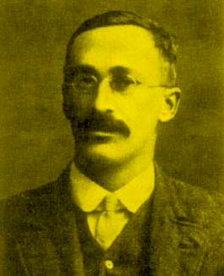
Confidence Intervals
Confidence Intervals
Use V for σ.
Solution:
If X_{k}’s are i.i.d . Gaussian - so is Z
William S. Gosset
1876-1937
If X_{k}’s are i.i.d . Gaussian, then T is a Student’s t distribution with n-1 DOF.
First published by W.S. Gosset under the pseudonym A. Student.

Slide 5
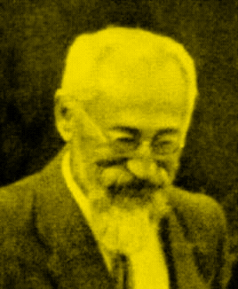
Confidence Intervals
Confidence Intervals
The pdf of a Student’s t distribution with n-1 DOF.
William S. Gosset
1876-1937
Bad news: No closed form integration available. Must use table (see p.291).
Good news: As n→∞, (n > 31) the Student’s t distribution with n-1 DOF approaches a zero mean unit variance Gaussian (CLT).

Slide 6

Confidence Intervals
Confidence Intervals
Example: Choose 1000 entries at random. You saw 182 of them.
Point estimate of X = # of movies seen.
A = p = 0.182
N = 0.182×18,000 = 3276 movies seen!
95% confidence, 2 erf(z)=0.95 or z = 1.96
  σ² ≈ p (1-p) =0.148876.

