Slide 1

EE 5354
Sums of RV’s and Long-Term Averages (The Central Limit Theorem)

Slide 2
The Central Limit Theorem
S = sum of n i.i.d. RV’s
Define
Notes: (1) We assume the mean & variance of X are defined & finite. No Cauchy! (2) Z is zero mean with unit variance.

Slide 3
The Central Limit Theorem
= the CDF of a zero mean unit variance Gaussian RV.
Recall…
See pp. 281-283

Slide 4
The Central Limit Theorem (Example)
Rounding off the cents in a column sum. X = rounding error ~ uniform from -$½ to $½. S= total error.
; E[X]= $ 0, var(X)= ¹/₁₂ $².
Q1: n =10. What is the probability the total error is over $10?
Q2: What is n when Pr[|S| > $100] = 0.5 ?

Slide 5
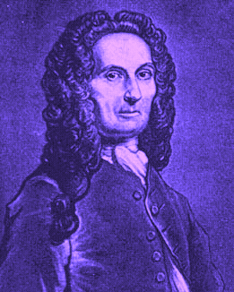
The Central Limit Theorem (Example)
Q: The sum of n i.i.d. Bernoulli RV’s with success probability p is a binomial RV. As n→∞, does the CLT also say this sum approaches a Gaussian with mean np and variance np(1-p)?
A: Yes. This is the DeMoivre-Laplace theorem.
Abraham de Moivre
(1667-1754)

Slide 6
The Central Limit Theorem
Recall: for i.i.d. RV’s, if then
S is Gaussian if the X_{k}’s are Gaussian. As n→∞, Gaussian.
S is Binomial if the X_{k}’s are Binomial. As n→∞, Gaussian.
S is Poisson if the X_{k}’s are Poisson. As n→∞, Gaussian.
S is Gamma if the X_{k}’s are Gamma. As n→∞, Gaussian.
S is Negative Binomial if the X_{k}’s are Negative Binomial. As n→∞, Gaussian.
S is Cauchy if the X_{k}’s are Cauchy. As n→∞, still Cauchy.

Slide 7

The Central Limit Theorem
Proof - some fundamentals.
Lemma
Proof: LaHospital
For small ε

Slide 8
The Central Limit Theorem
Proof - cont.
Preliminaries
Gaussian
characteristic
function
Proof outline - we will show…

Slide 9

The Central Limit Theorem
Proof - cont.
Preliminaries

Slide 10
The Central Limit Theorem
Proof - cont.
Continuing…
Since the X_{k}’s are i.i.d.

Slide 11
The Central Limit Theorem
Proof - conclusion.
= 0
Continuing…

