Slide 1


ECE 5354
Sums of RV’s and Long-Term Averages
The Law of Large Numbers

Slide 2
Sum of RV’s
Sum
Mean of the sum
If i.i.d.

Slide 3
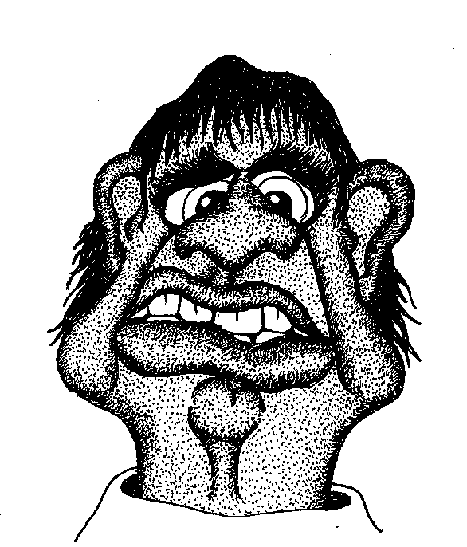
Sum of RV’s
Variance

Slide 4
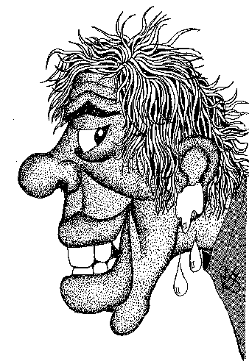
Sum of RV’s
Variance: Special case: independent RV’s
The Kronecker delta is
Thus…

Slide 5

Sum of RV’s
For i.i.d. RV’s, if
The mean is…
The variance is…

Slide 6
Sum of RV’s: The Characteristic Function
For i.i.d. RV’s, if
Then…
And…
Note: can find the same result for mean and variance by differentiation and substitution.

Slide 7
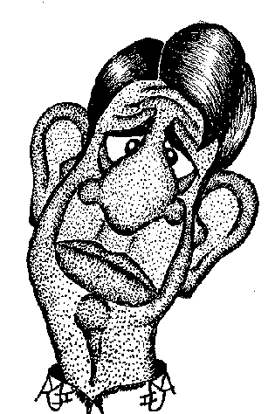
Recall: for i.i.d. RV’s
Then…
S is Gaussian if the X_{k}’s are Gaussian.
S is Poisson if the X_{k}’s are Poisson.
S is Binomial if the X_{k}’s are Binomial.
S is Gamma if the X_{k}’s are Gamma.
S is Cauchy if the X_{k}’s are Cauchy.
S is Negative Binomial if the X_{k}’s are Negative Binomial

Slide 8
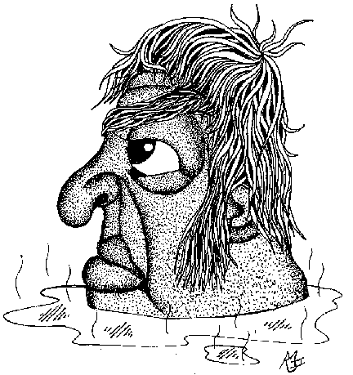
The Average (Sample Mean)
Then…

Slide 9
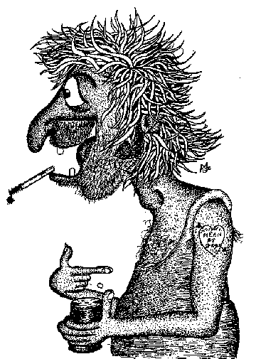
The Average
If samples are i.i.d…
Thus…

Slide 10
The Average of i.i.d. RV’s
The average…
If samples are i.i.d…
And…

Slide 11
Mean and Variance of the Average of i.i.d. RV’s
Thus…
Or…
As it should be!

Slide 12
Mean and Variance of the Average of i.i.d. RV’s
Thus…
Or…
Makes Sense!

Slide 13
Mean and Variance of the Average of i.i.d. RV’s
pdf’s…
A
A for bigger n
X
x
X

Slide 14

Apply Chebyshev to Average of i.i.d. RV’s
Chebyshev…
Since…
And…
Thus…

Slide 15
The Weak Law of Large Numbers
This gives, in the limit, the “weak law of large numbers”
The average, in this sense, approaches the mean.

Slide 16
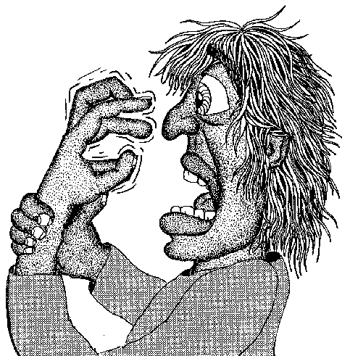
The Strong Law of Large Numbers
This is a stronger statement:

Slide 17
Sloppy Confidence Intervals on Bernoulli Trials
Unknown p parameter in Bernoulli trial.
E(X)=E(A)=p, var(X)=p(1-p)≤ ¼
The weak law of large numbers gives:

Slide 18
Sloppy Confidence Intervals on Bernoulli Trials (cont)
Assume we want to be 95% or more sure that the result is within 1% of being correct. How many samples do we need to take to assure this?
Set
Solving gives n=50,000.
Chebyshev gives loose bounds. There are better ways to do this.

Slide 19
Sample Variance
The average (or sample mean) is used to estimate the variance.
The sample variance is used to estimate the variance.
Note: A and V can be shown to be independent RV’s.

Slide 20
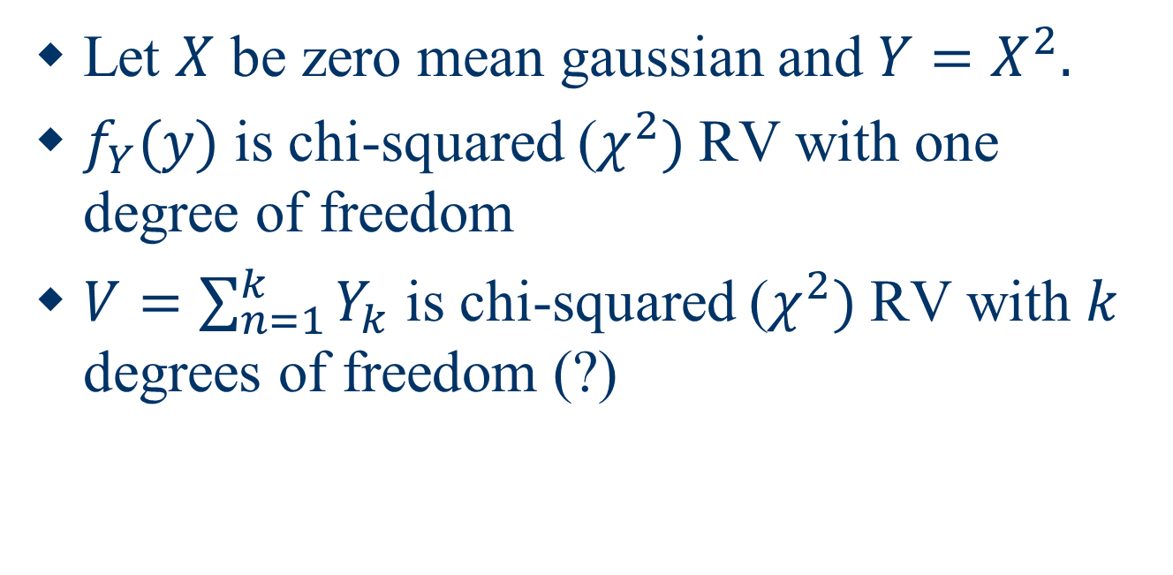
Chi Squared
Let $X$ be zero mean gaussian and $Y=X^{2}.$
$f_{Y}(y)$ is chi-squared ($χ^{2})$RV with one degree of freedom
$V=\sum_{n=1}^{k}{Y_{k}}$ is chi-squared ($χ^{2})$RV with $k$ degrees of freedom (?)

