Slide 1
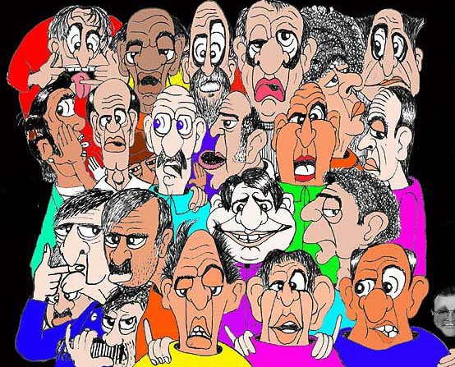
Information & Entropy

Slide 2
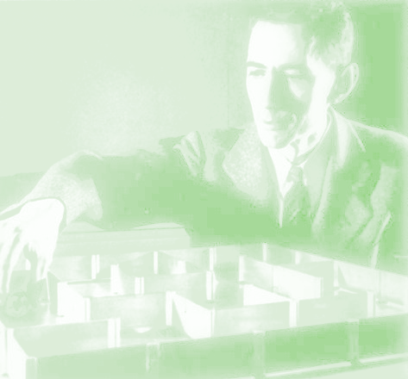
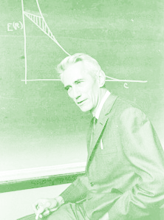
Shannon Information Axioms
Small probability events should have more information than large probabilities.
  “the nice person” (common words → lower info)
  “philanthropist” (less used → more information)
Information from two disjoint events should add
  “engineer” → Information I₁
  “stuttering” → Information I₂
  “stuttering engineer” → Information I₁ + I₂

Slide 3
Shannon Information
I
p

Slide 4
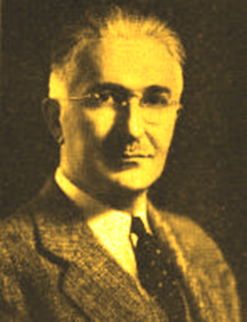
Information Units
log₂ – bits
log_{e} – naps
log₁₀ – ban or a hartley
Ralph Vinton Lyon Hartley (1888-1970)
inventor of the electronic oscillator circuit that bears his name, a pioneer in the field of Information Theory

Slide 5
Illustration
Q: We flip a coin 10 times. What is the probability we come up the sequence
0 0 1 1 0 1 1 1 0 1?
Answer
How much information do we have?

Slide 6
Illustration: 20 Questions
Interval halving: Need 4 bits of information

Slide 7
Entropy
Bernoulli trial with parameter p
Information from a success =
Information from a failure =
(Weighted) Average Information
Average Information = Entropy

Slide 8
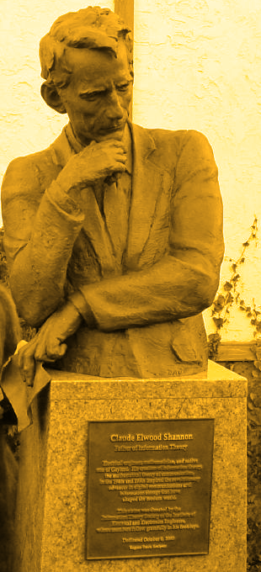
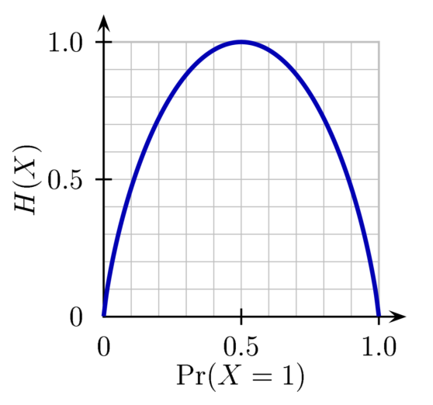
The Binary
Entropy Function
p

Slide 9
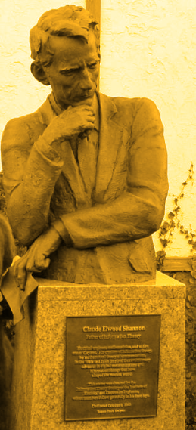

Entropy Definition
=average Information

Slide 10
Entropy of a Uniform Distribution

Slide 11
Entropy as an Expected Value
where

Slide 12
Entropy of a Geometric RV
then
H = 2 bits when p=0.5

Slide 13


Entropy doesn’t care about location
_{¼}
$$H=2$$
_{¼}
$$H=2$$

Slide 14


Relative Entropy

Slide 15

Relative Entropy Property
Equality iff p=q

Slide 16
Relative Entropy Property Proof
Since

Slide 17

Uniform Probability is Maximum Entropy
Relative to uniform:
Thus, for K fixed,

Slide 18

Entropy as an Information Measure: Like 20 Questions
16 Balls
Bill Chooses One
1
1
1
1
2
2
2
2
3
3
4
4
5
6
7
8
You must find which ball with binary questions. Minimize the expected number of questions.

Slide 19
One Method...
1
1
1
1
2
2
2
2
3
3
4
4
5
6
7
8
1
2
3
4
5
6
7
8
no
no
no
no
no
no
no
yes
yes
yes
yes
yes
yes
yes

Slide 20
Another (Better) Method...
no
no
no
yes
yes
yes
yes no
7
8
yes no
yes no
yes no
1
2
3
4
5
6
1
1
1
1
Longer paths have smaller probabilities.
2
2
2
2
3
3
4
4
5
6
7
8

Slide 21
no
no
no
yes
yes
yes
yes no
7
8
yes no
yes no
yes no
1
1
1
1
1
2
3
4
5
6
2
2
2
2
3
3
4
4
5
6
7
8

Slide 22
Relation to Entropy...
1
1
1
1
2
2
2
2
3
3
4
4
The Problem’s Entropy is...
5
6
7
8

Slide 23
Principle...
1
1
1
1
2
2
2
2
3
3
4
4
The expected number of questions will equal or exceed the entropy.
There can be equality only if all probabilities are powers of ½.
5
6
7
8
1
1
1
1
1
1
1
1
1
1
1
1
2
2
2
2
2
2
2
2
2
2
2
2
3
3
4
4
3
3
4
4
3
3
4
4
5
6
7
8
5
6
7
8
5
6
7
8

Slide 24
Principle Proof
1
1
1
1
Lemma: If there are k solutions and the length of the path to the k th solution is , then
2
2
2
2
3
3
4
4
5
6
7
8

Slide 25

Principle Proof
$$≥0$$
= the relative entropy with respect to
Since the relative entropy always is nonnegative...

