Slide 1

EE 5345
Functions of a RV

Slide 2

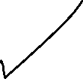
Transformation on a RV
Given f_{X}(x) and Y=g(X) find f_{Y}(x)
Solution:
Solve roots of x and y=g(x). Call them…
Transformation is

Slide 3
Transformation on a RV (cont)
Special case: Y=g(X) where y=g(x) is strictly increasing.
Notes
  If a < b then g(a) < g(b)
y=g(x )
g(b )
g(a)
x
a b

Slide 4
Transformation on a RV (cont)
Notes (cont)
  If y=g(x) is strictly increasing, so is x=g⁻¹(y)
x=g⁻¹(y)
y=g(x )
x=g⁻¹(y)
y=g(x )
Example: y=e^{x}=g(x) and x=ln (y)=g⁻¹(y).

Slide 5
Transformation on a RV (cont)
Transformation when y=g(x) is strictly increasing

Slide 6
Transformation on a RV (cont)
Transformation when y=g(x) is strictly increasing (cont)

Slide 7
Transformation on a RV (cont)
Transformation when y=g(x) is strictly increasing (cont)
x=g⁻¹(y)
y=g(x )
x=g⁻¹(y)
y=g(x )

Slide 8
Transformation on a RV (cont)
More generally, if y=g(x) is strictly increasing or strictly decreasing

Slide 9
Transformation on a RV (cont)
Most general: Given f_{X}(x) and Y=g(X) find f_{Y}(x)
Solution:
Solve roots of x and y=g(x). Call them…
Transformation is
g(x)
y
x₁ x₂ x₃
x

Slide 10
Transformation on a RV (cont)
Other points
  Visualization: Mapping of probability mass:
  Mapping when y=g(x)is constant for an interval:
   Map to Dirac deltas
y
y
y=g(x)
f_{Y}(y)
x
f_{X}(x)
x

Slide 11
Simple Transformations
Transposition: Y = -X
Shift: Y = X+s
Scale: Y = aX

Slide 12
Simple Transformations(cont)
Modulus: Y = |X|
Shift & Scale: Y = aX + s

Slide 13
Generating RV’s
Uniform & Gaussian
RV’s available
Transformation allows
generation of other RV’s.
Ex: When X is uniform
  Y = ln(X) gives an exponential RV
  Y=tan(X) gives Cauchy
Note: Mappings are not unique!

Slide 14
Synthesizing RV’s (cont)
Given a uniform RV on (0,1), find y=g(x) so that Y is distributed as f_{Y}(y). One solution: y=F_{Y} ⁻¹(x)

Slide 15
Synthesizing RV’s (cont)
The converse problem: Given f_{X}(x), find y=g(x) so that Y is uniform on (0,1). One solution: y=F_{X}(x).
These solutions are not unique.

Slide 16
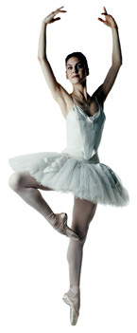
RV Expected Values
nth moment
mean (center of mass)
variance (measure of dispersion)
E(x)

Slide 17
RV Expected Values (cont.)
E(x)

Slide 18
RV Expected Values (cont.)
Some random variables have means = ∞. For example
F_{X}(x)=1 - ¹/_{x} ; x>1
E(x)

Slide 19
RV Expected Values (cont.)
Some random variables have infinite second moments (e.g. Cauchy).
E(x)

Slide 20
Discrete RV Expected Values
For lattice discrete RV’s, k_{n}=n
Example lattice discrete RV’s
  Poisson
  Binomial
  Bernoulli
E(x)

Slide 21
Discrete RV Moments
For lattice discrete RV’s
50-50 coin flip
  Heads = 0. Tails = 1.
  E(X) = ¹/₂
  The expected value need not be a realizable value of the random variable.
E(x)

Slide 22
Discrete RV Moments (cont)
Saint Petersburg Gambling
Rules: Let X be the number of coin flips before the first head.
Pr[X = k]=2^{-k}.
Payoff: Y=2^{k} dollars.
Q: If you ran this game in Las Vegas, what would you charge to play? What is E(Y)?
A: ∞.

Slide 23
Characteristic Function
Properties

Slide 24
Characteristic Function
If X and Y are independent
From the convolution theorem of Fourier transforms
Foundation of Central Limit Theorem

Slide 25
Second Characteristic Function
Definition
Ψ_{X}(x)=ln Φ _{X}(x)
Properties

Slide 26
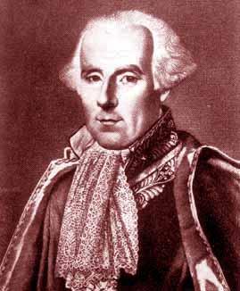
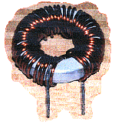
Moment Generating Function
Laplace transform of PDF
Moment Generating Function

Slide 27
MGF Properties
Moment Generation
Taylor Series

Slide 28
Probability Generating Function
Z transform probability mass function (pmf)
where

Slide 29
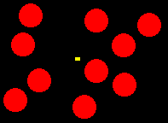
PGF Properties
Mean and Variance

Slide 30
Common Models
Bernoulli, p = probability of success

Slide 31
Common Models (cont)
Binomial (n repeated Bernoulli trials)

Slide 32

Common Models (cont)
Geometric
$$P\left[X=k\right]=p{\left(1−p\right)}^{k−1};k=1,2,3,⋯$$

Slide 33
Common Models (cont)
Pascal or Negative Binomial

Slide 34
Common Models (cont)
Poisson

Slide 35
Common Models (cont)
Uniform

Slide 36
Common Models (cont)
Gaussian or Normal

Slide 37
Common Models (cont)
Exponential

Slide 38
Common Models (cont)
Laplace

Slide 39
Common Models (cont)
Gamma

Slide 40
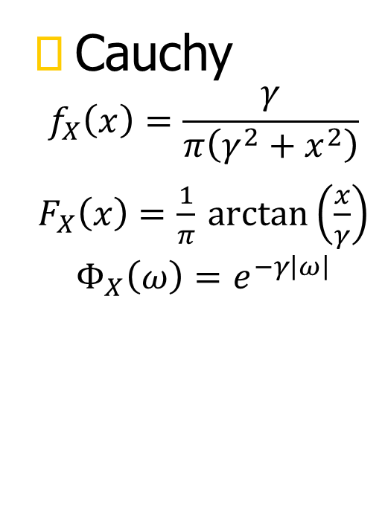
Common Models (cont)
Cauchy
$$f_{X}\left(x\right)=\frac{γ}{π\left(γ^{2}+x^{2}\right)}$$
$F_{X}\left(x\right)=\frac{1}{π}$ $\arctan\left(\frac{x}{γ}\right)$
$$Φ_{X}\left(ω\right)=e^{−γ\left|ω\right|}$$

Slide 41
Means & Variance
Recall

Slide 42
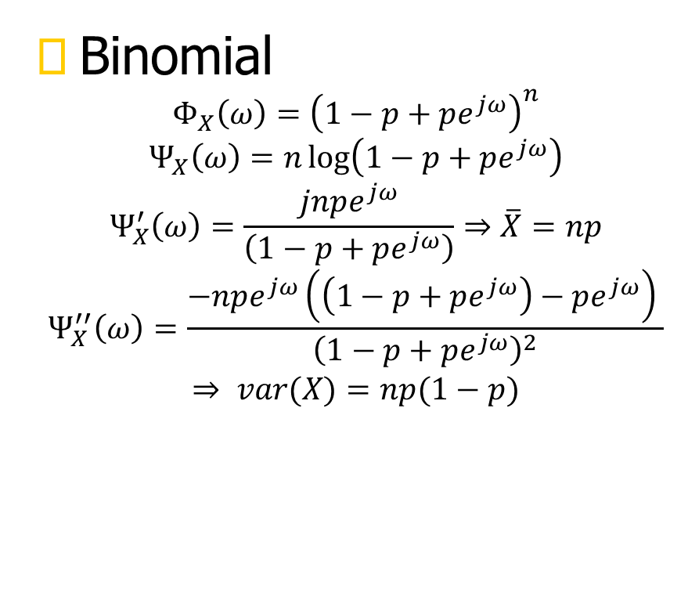
Means & Variance
Binomial
$$Φ_{X}\left(ω\right)={\left(1−p+pe^{jω}\right)}^{n}$$
$$Ψ_{X}\left(ω\right)=n\log\left(1−p+pe^{jω}\right)$$
$$Ψ_{X}^{′}\left(ω\right)=\frac{jnpe^{jω}}{\left(1−p+pe^{jω}\right)}⇒\overline{X}=np$$
$$Ψ_{X}^{′′}\left(ω\right)=\frac{−npe^{jω}\left(\left(1−p+pe^{jω}\right)−pe^{jω}\right) }{{\left(1−p+pe^{jω}\right)}^{2}}$$
$$⇒ var(X)=np(1−p)$$

Slide 43
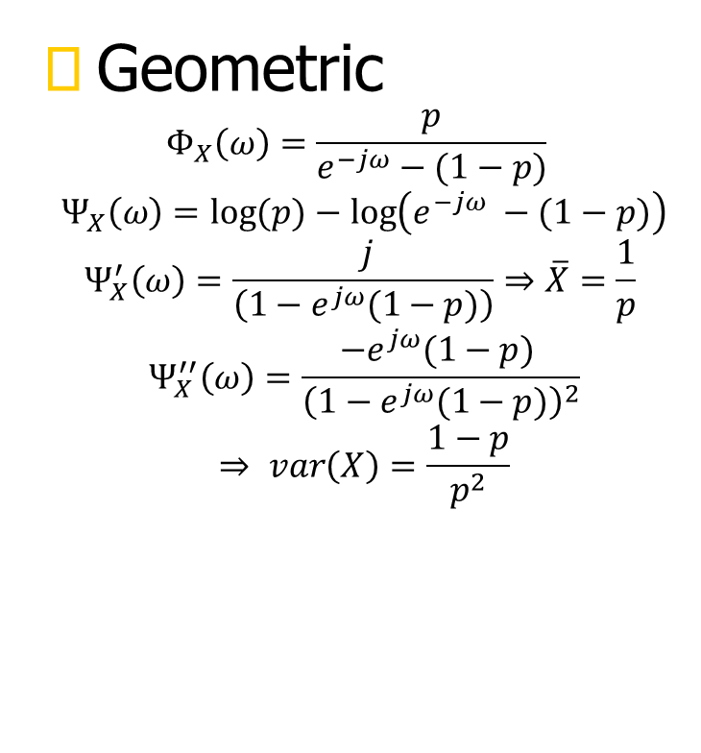
Means & Variance
$$P\left[X=k\right]=p{\left(1−p\right)}^{k−1};k=1,2,3,⋯$$
Geometric
$$Φ_{X}\left(ω\right)=\frac{p}{e^{−jω}−(1−p)}$$
$$Ψ_{X}\left(ω\right)=\log{(p)}−\log\left(e^{−jω} −(1−p)\right)$$
$$Ψ_{X}^{′}\left(ω\right)=\frac{ j}{\left(1−e^{jω}(1−p)\right)}⇒\overline{X}=\frac{1}{p}$$
$$Ψ_{X}^{′′}\left(ω\right)=\frac{{−e}^{jω}(1−p) }{{\left(1−e^{jω}(1−p)\right)}^{2}}$$
$$⇒ var\left(X\right)=\frac{1−p}{p^{2}}$$

Slide 44
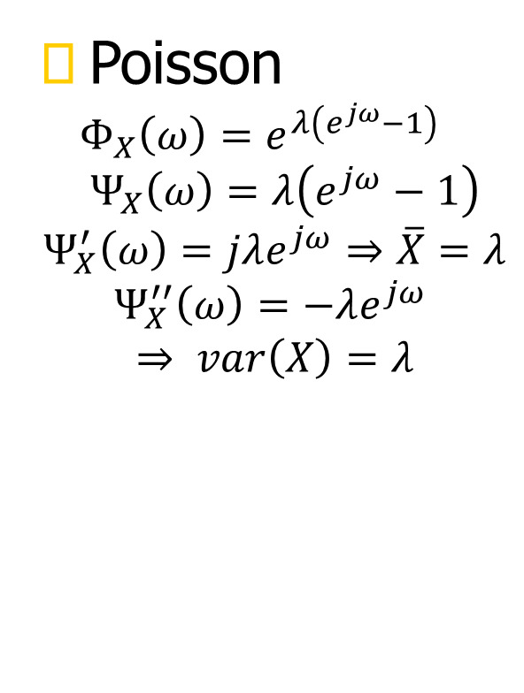
Means & Variance
Poisson
$$Φ_{X}\left(ω\right)=e^{λ\left(e^{jω}−1\right) }$$
$${ Ψ}_{X}\left(ω\right)=λ\left(e^{jω}−1\right)$$
$$Ψ_{X}^{′}\left(ω\right)=jλe^{jω}⇒\overline{X}=λ$$
$$Ψ_{X}^{′′}\left(ω\right)=−λe^{jω}$$
$$⇒ var\left(X\right)=λ$$

Slide 45
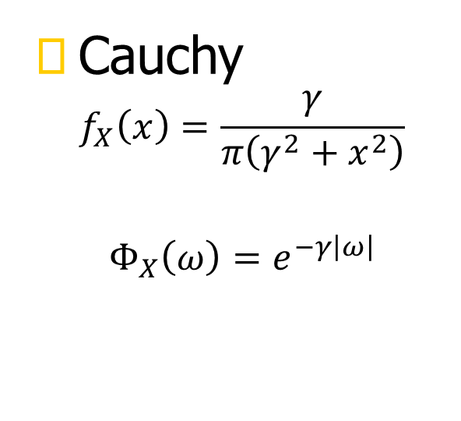
Means & Variance
Cauchy
$$f_{X}\left(x\right)=\frac{γ}{π\left(γ^{2}+x^{2}\right)}$$
$$Φ_{X}\left(ω\right)=e^{−γ\left|ω\right|}$$

Slide 46
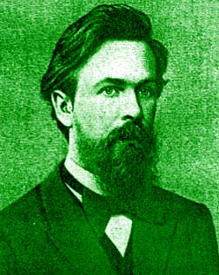
Tail Inequalities: Markov
If f_{X}(x)= f_{X}(x)μ (x) then
f_{X}(x)
a
x
Andrei Andreyevich Markov
Born: 14 June 1856 in Ryazan, Russia
Died: 20 July 1922 in St Petersburg, Russia
Proof: p. 137

Slide 47
Markov’s Inequality: Proof
f_{X}(x)
a
x
quod erat demonstrandum

Slide 48
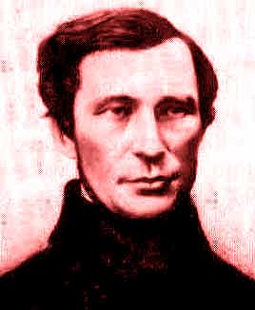
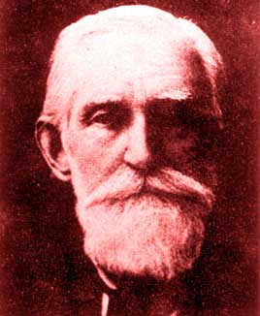
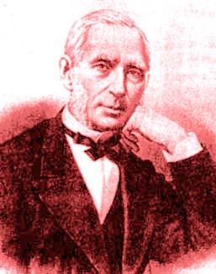
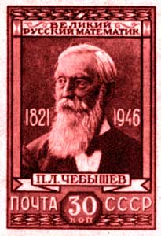
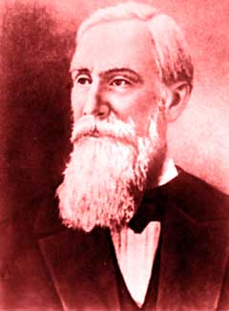
Tail Inequalities: Chebyshev
2a
f_{X}(x)
Pafnuty Lvovich Chebyshev
Born: 16 May 1821 in Okatovo, Russia
Died: 8 Dec 1894 in St Petersburg, Russia
x
p.137

Slide 49
Chebyshev’s Inequality: Proof
p.137

Slide 50
Tail Inequalities: Chebyshev
Chebyshev’s inequality illustrates the variance as a measure of dispersion. As the variance increases, the bound noted by the shaded area of the tails, becomes larger and larger suggesting the distribution is spreading out more and more.
2a
f_{X}(x)
x

Slide 51

The Chernoff Bound
f_{X}(x)
a
x

