Slide 1
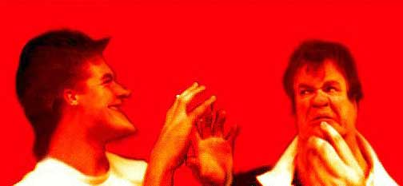
ENGR 5345
Review of Probability & Random Variables

Slide 2

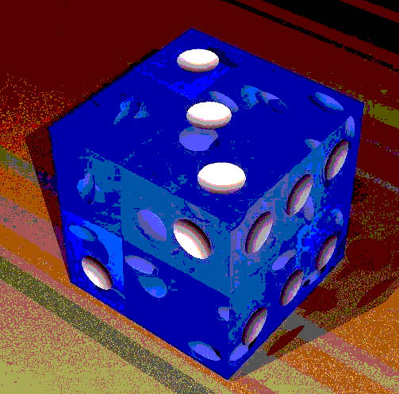
Review
Probability: A MODEL of Reality
Probability[Event]
3 Models (Probability Definitions)
1. Classical Definition

Slide 3
Classical Definition (cont)
An Example Problem:
Choose a chord at random that intersects the big circle.
Answers:
  (a) 0.25
  (b) 0.33
  (c) 0.50
  (d) All of the above
●
r
½r
Note: when the chord is tangent to small circle.

Slide 4
Classical Definition (cont)
(a) if the chord’s center is in middle center circle.
●
r
½r

Slide 5
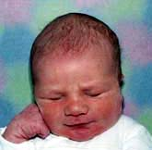
Classical Definition (cont)
(b) WLOG, anchor one of the chord’s ends.
●
r
½r
A
puzzlement!

Slide 6
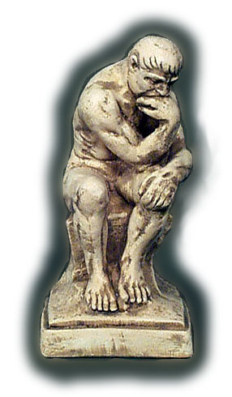
Classical Definition (cont)
(c) Construct ⊥ to chord.
●
r
½r
A REAL
puzzlement!

Slide 7
Answer (?)
Choose a chord at random that intersects the big circle.
Answers:
  (a) 0.25
  (b) 0.33
  (c) 0.50
  (d) All of the above?!?
●
r
½r
Q: What is the resolution to the Bertrand paradox?

Slide 8
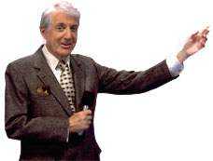



The Monty Hall Problem
Problem: Three curtains. Lava Lamps behind two. $1,000,000 behind another.
Steps:
  You choose curtain.
  Game Host Shows you a lava lamp behind another curtain.
  Should you change or keep your original choice?
Curtain 1
.
Curtain 2
.
Curtain 3
.

Slide 9
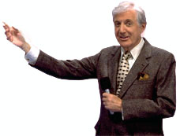
The Monty Hall Problem (cont)
Answer: Switching original choice doubles your chance of winning the money.
Curtain 1
.
Curtain 2
.
Curtain 3
.
http://www.stat.sc.edu/~west/javahtml/LetsMakeaDeal.html

Slide 10
Deal or No Deal
Problem: There are three doors. Behind each is a sum of money. Each has a different amount of money. That’s all you know.
Rules: You choose the doors to be opened. The first door is opened. You look at the result and decide whether to open another door.

Slide 11
Deal or No Deal
If you open the second door, you may no longer have the money behind the first door. You can, if you like, open all three doors. If you do, you keep the money behind the third door.
At any time you like, you say “DEAL”. You keep the money behind the last door opened.
Problem: What strategy do you use to maximize the chance you get the most money???

Slide 12


Probability Models (Cont)
2. Relative Frequency Definition
(a) Monte Carlo Simulation
(b) Estimate π by throwing darts:
r
⇐ dart board

Slide 13
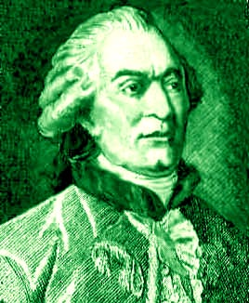
Relative Frequency Examples
(c) Buffon’s Needle
2a
2b
Georges Buffon
Born: 7 Sept 1707 in Montbard, Côte d'Or, France
Died: 16 April 1788 in Paris, France
b > a

Slide 14
Probability Models (Cont)
3. Axiomatic Definition
S = Universal Set
Axiom 1:
Axiom 2:
Axiom 3a:
Axiom 3b: {A_{i} | 1≤ i ≤∞} be pairwise disjoint.

Slide 15
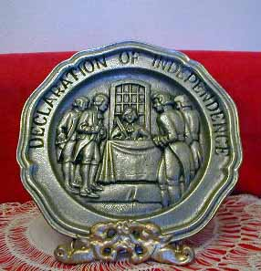
Event Types
A and B independent:
Pr[A•B]= Pr[A] Pr[B]
For three sets A, B and C…
    Pr[A•B]= Pr[A] Pr[B]
    Pr[A•C]= Pr[A] Pr[C]
    Pr[B•C]= Pr[B] Pr[C]
    Pr[A•B•C]= Pr[A] Pr[B] Pr[C]

Slide 16
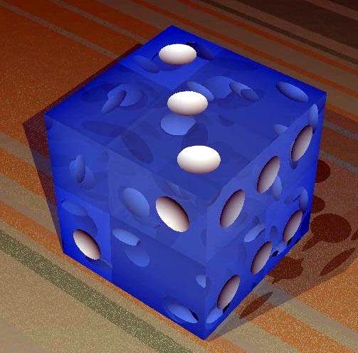
Independent Events (example)
A = sum of two dice is seven
B = dots on die #1 is six
C = dots on die #2 is three
Pairwise checks but 3 way doesn’t ⇒ ∴ not independent
Pr[A•B]= Pr[A] Pr[B] = 1/36
Pr[A•C]= Pr[A] Pr[C] = 1/36
Pr[B•C]= Pr[B] Pr[C] = 1/36
Pr[A•B•C] = 0 ≠ Pr[A] Pr[B] Pr[C] = 1/216

Slide 17
Event Types (cont)
A and B are mutually exclusive...
A ∩ B = φ
    ⇒ Pr[A • B] = 0
    & Pr[ A + B ] = Pr[A] + Pr[B]
Q: Can 2 sets be both independent and mutually exclusive?
A: Yes. If one or both are empty
Q: Does Pr[ A + B ] = Pr[A] + Pr[B] ⇒ A & B are M.E.?

Slide 18
Conditional Probability
= Probability of A given B.
Theorem: If A and B are independent,
Q: What if A and B are M.E.?

Slide 19
Universal Set Partition
A partition is of components that are M.E.⇒
and exhaustive ⇒
A₁
A₃
A₄
S
Venn
Diagram
A₂
A₅

Slide 20
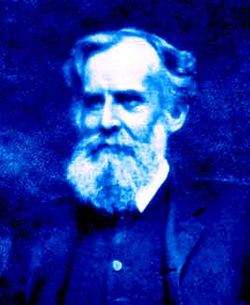
Theorem of Total Probability
Let {A_{i}} be a partition of S. Then
A₃
A₁
A₄
S
B
Venn
Diagram
A₂
A₅
John Venn
Born: 4 Aug 1834 in Hull, England
Died: 4 April 1923 in Cambridge, England

Slide 21
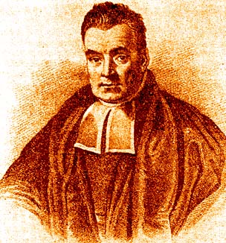
Bayes Theorem
Derivation…
Thus…
Reverend Thomas Bayes
Born: 1702 in London, England
Died: 17 April 1761 in Tunbridge Wells, Kent, England

Slide 22
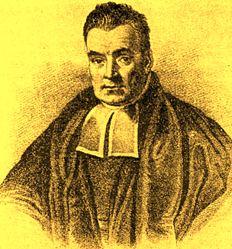
Thomas Bayes (1702 – 1761)
Bayes Theorem
Baysian Inference: Making classifications using an historical data base.
Foundation of most modern email spam filters.
Thomas Bayes, Divine Benevolence,1731, and D.R. Bellhouse, “The Reverend Thomas Bayes FRS: a Biography to Celebrate the Tercentenary of his Birth” <http://www.stats.uwo.ca/faculty/bellhouse/bayesbiog.pdf>

Slide 23
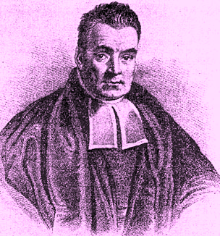
Thomas Bayes (1702 – 1761)
Reverend Bayes was a pastor of the Presbyterian Chapel in Tunbridge Wells, 35 miles southeast of London.
Bayes didn’t bother to publish his mathematical work. It was all published posthumously. Bayes was elected Fellow of the Royal Society in 1742 having no published works on mathematics.
Bayes did publish about his faith. “God always does that which is right and fit, and that all his moral attributes, [namely] justice, truth, faithfulness, mercy, patience, [etc.] are but so many different modifications of rectitude.” Thomas Bayes, “Divine Benevolence”, 1731.
D.R. Bellhouse, “The Reverend Thomas Bayes FRS: a Biography to Celebrate the Tercentenary of his Birth” <http://www.stats.uwo.ca/faculty/bellhouse/bayesbiog.pdf>

