Slide 1
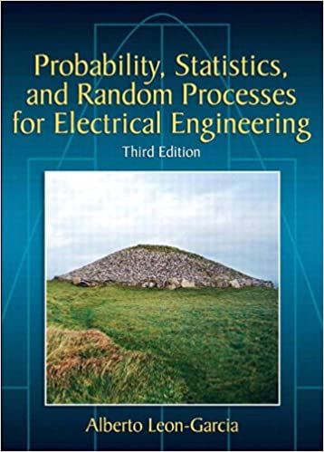
ENGR 5345
Link to course happenings:
https://docs.google.com/spreadsheets/d/1Zueo5Zn2TJcLdTBLd9H1U8eWDX8wO-FT_OxTsejiRoY/edit?usp=sharing

Slide 2
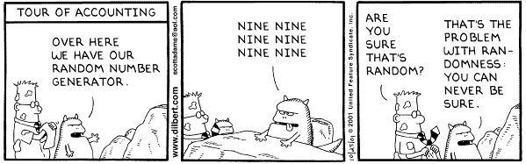
EE 5345

Slide 3
History
Leviticus 16:8
Aaron shall cast lots for the two goats, one lot for the Lord and the other lot for the scapegoat.
Numbers 26:55
But the land shall be divided by lot. They shall receive their inheritance according to the names of the tribes of their fathers.
Joshua 18:10
And Joshua cast lots for them in Shiloh before the Lord, and there Joshua divided the land to the sons of Israel according to their divisions.
Proverbs 18:18
The cast lot puts an end to strife
And decides between the mighty ones.
Matthew 27:35
And when they had crucified Him, they divided up His garments among themselves by casting lots.
Acts 1:26
And they drew lots for them, and the lot fell to Matthias; and he was added to the eleven apostles.

Slide 4
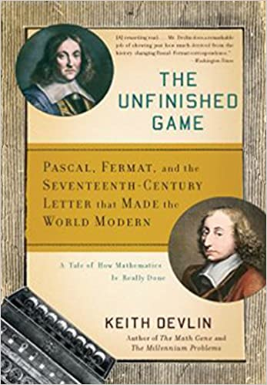
History
“In the early seventeenth century, the outcome of something as simple as a dice roll was consigned to the realm of unknowable chance. Mathematicians largely agreed that it was impossible to predict the probability of an occurrence.
“Then, in 1654, Blaise Pascal wrote to Pierre de Fermat explaining that he had discovered how to calculate risk. The two collaborated to develop what is now known as probability theory -- a concept that allows us to think rationally about decisions and events”

Slide 5
History
The Unfinished Game
Winner is the best of five tosses of a fair coin.
Winner takes all: $5000.
What happens if game is unfinished?
Pascal has two wins. Fermat one. Fermat dies.
How should the pot be divided?

